Slide 1
MUSIC RECOMMENDATION SYSTEM USER BASED COLLABORATIVE FILTERING
RESULTS

Slide 2
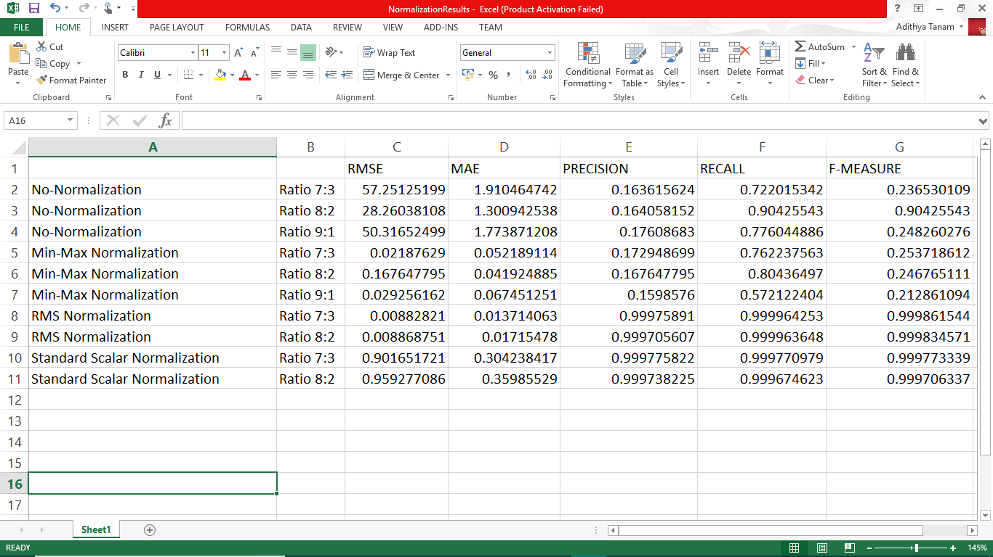
Table consisting of various evaluation values for different normalization Techniques

Slide 3
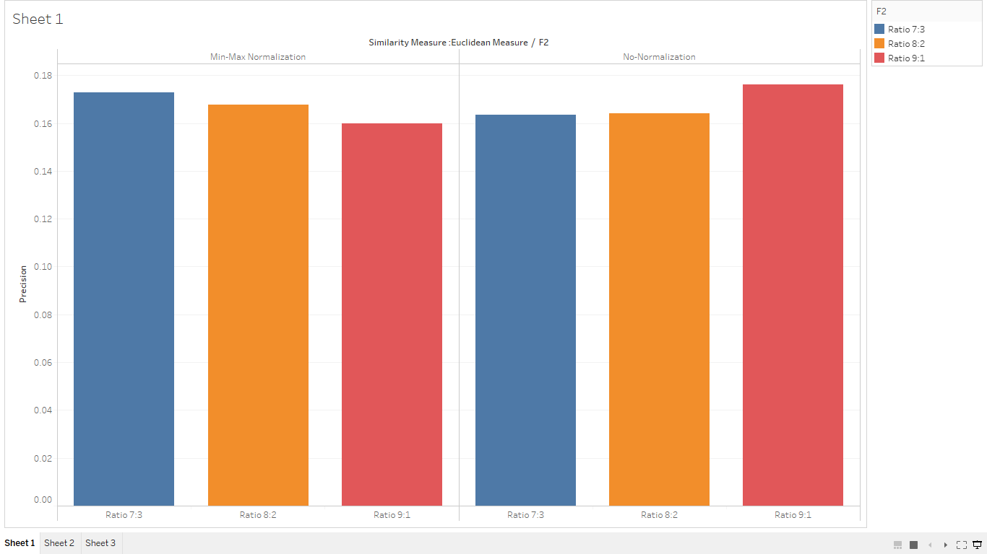
Graph for Precision of Min-max Normalization and No-normalization

Slide 4
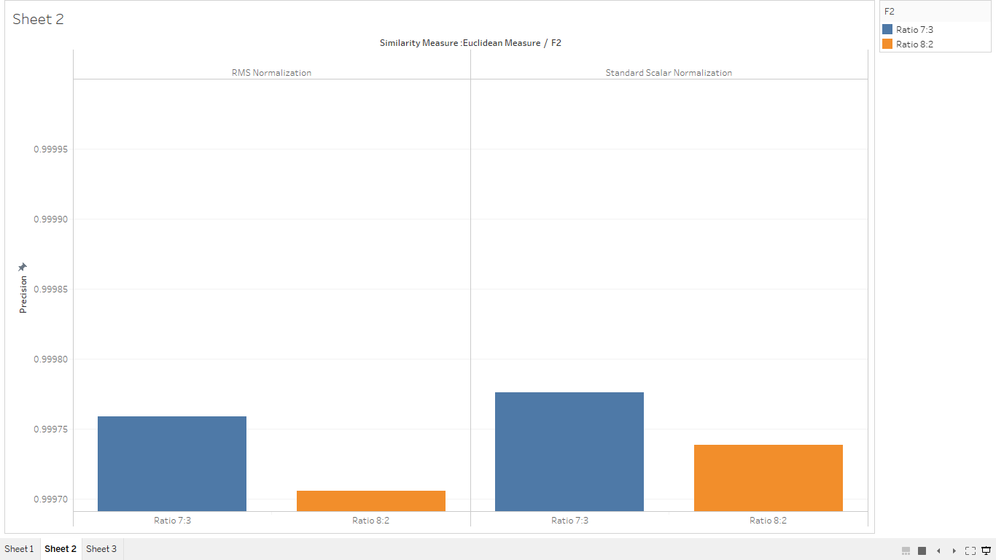
Graph for Precision of RMS Normalization and Standard Scaler normalization

Slide 5
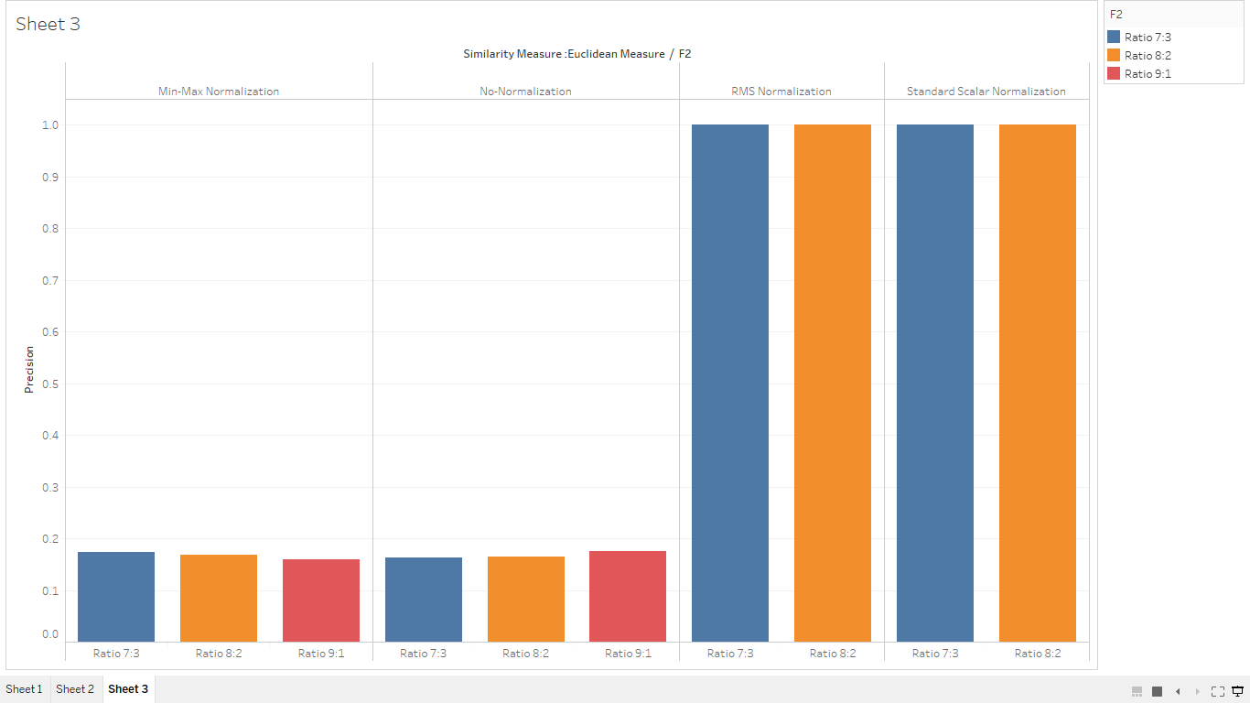
Comparison graph for Precision values of various Normalization Techniques

Slide 6
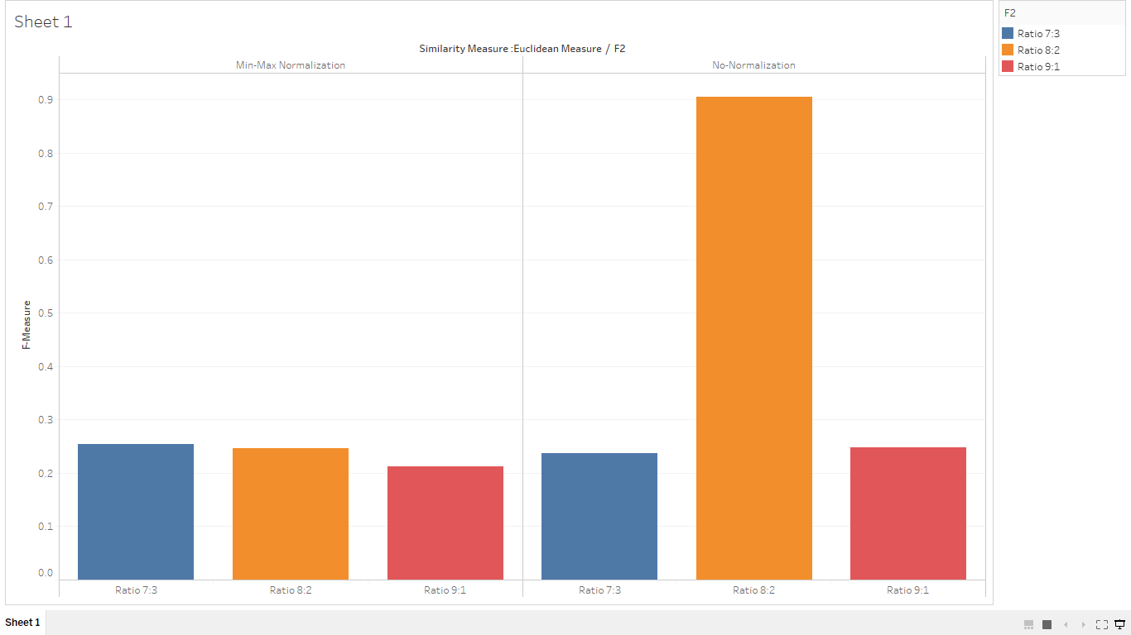
Graph for F-Measure of Min-max Normalization and No-normalization

Slide 7
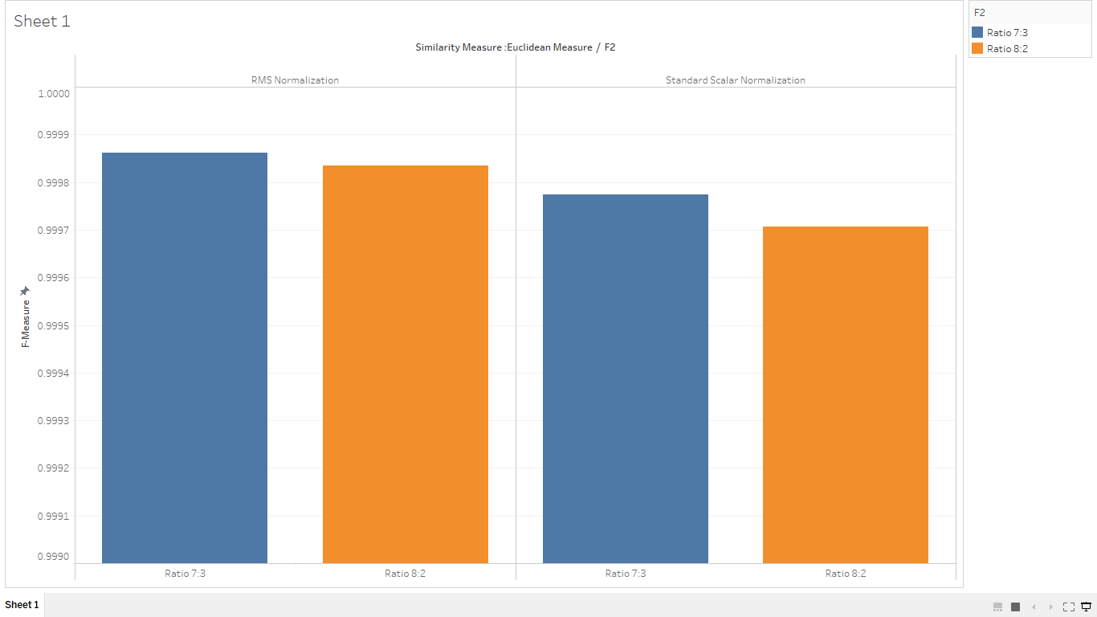
Graph for F-Measure of RMS Normalization and Standard Scaler normalization

Slide 8
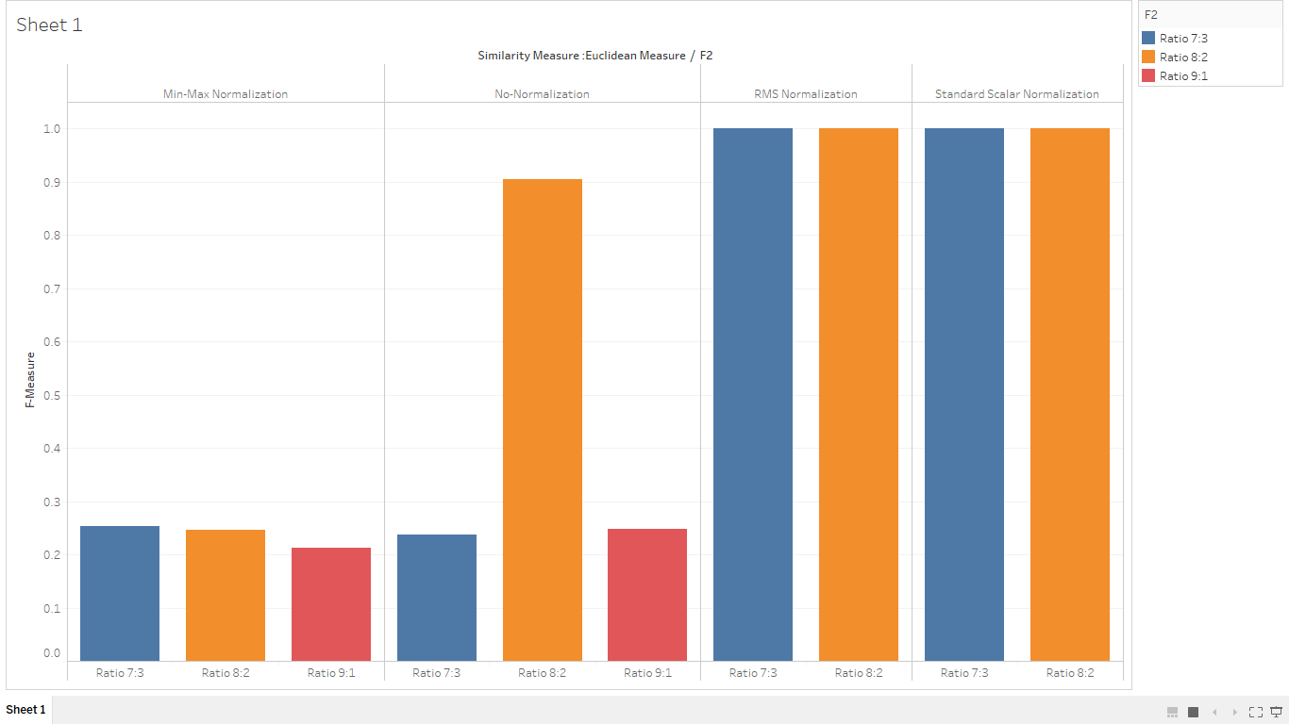
Comparison graph for F-Measure values of various Normalization Techniques

Slide 9
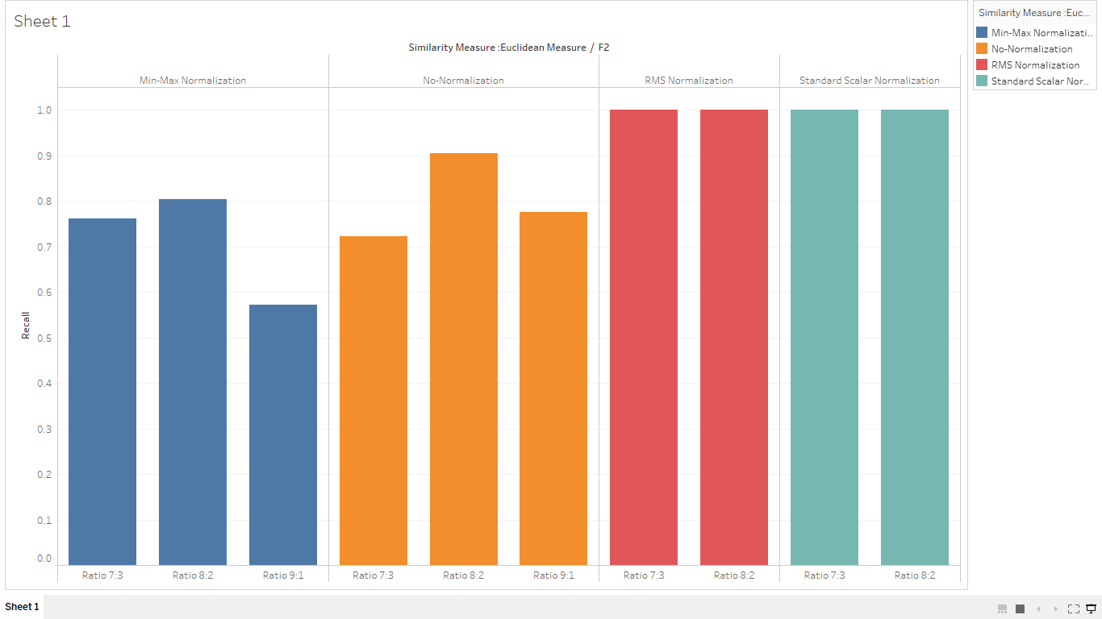
Comparison graph for Recall values of various Normalization Techniques

Slide 10
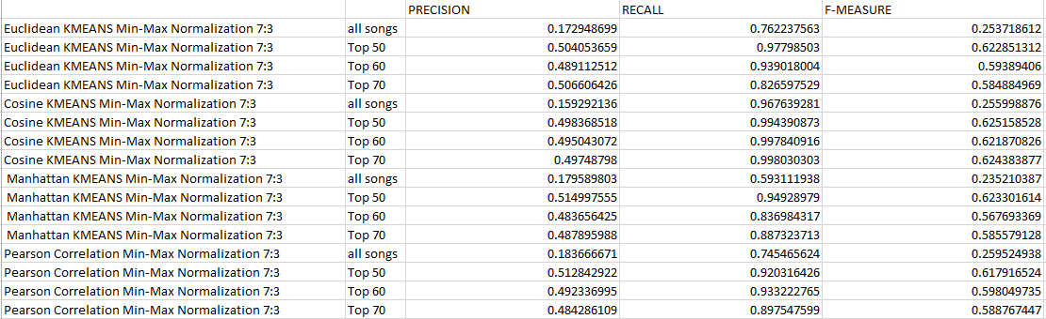
Evaluation Metrics for various similarity Measures

Slide 11
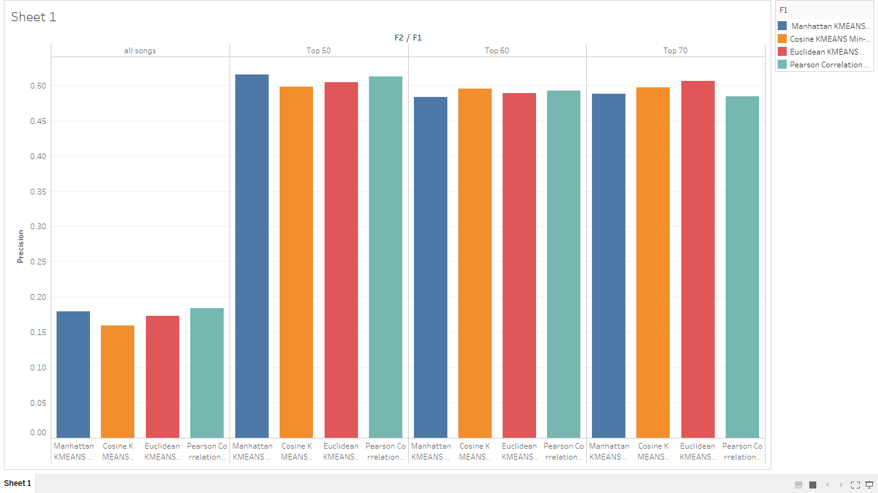
Graph for Precision values of various similarity Measures for different number

Slide 12
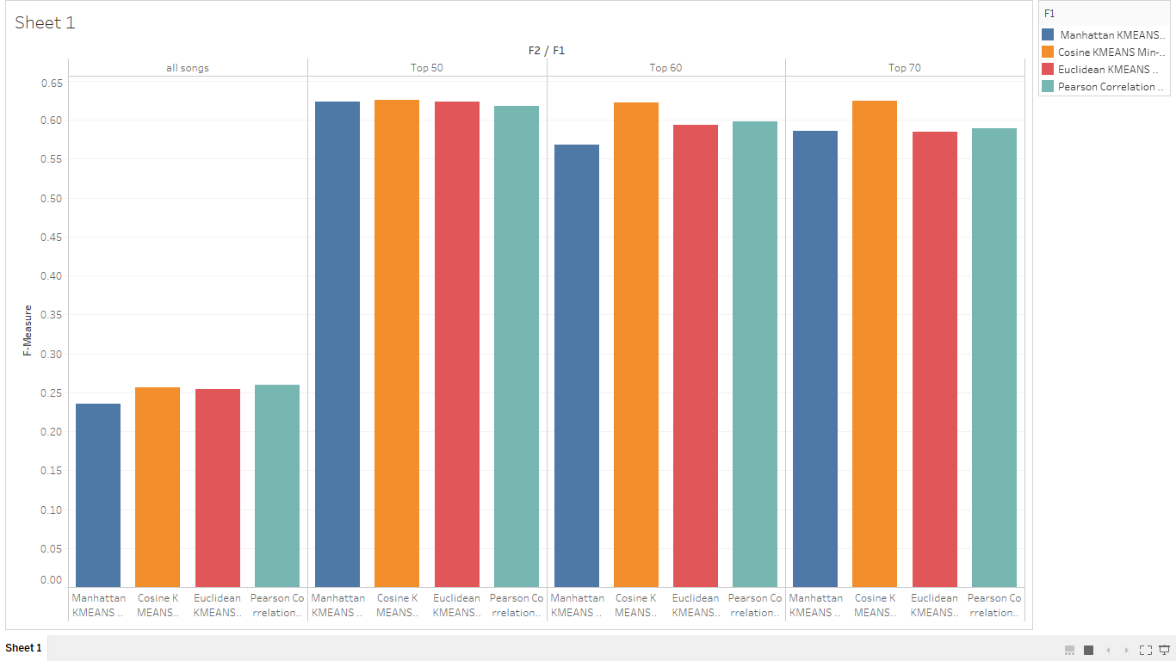
Graph for F-Measure values of various similarity Measures for different number of recommendation songs

Slide 13
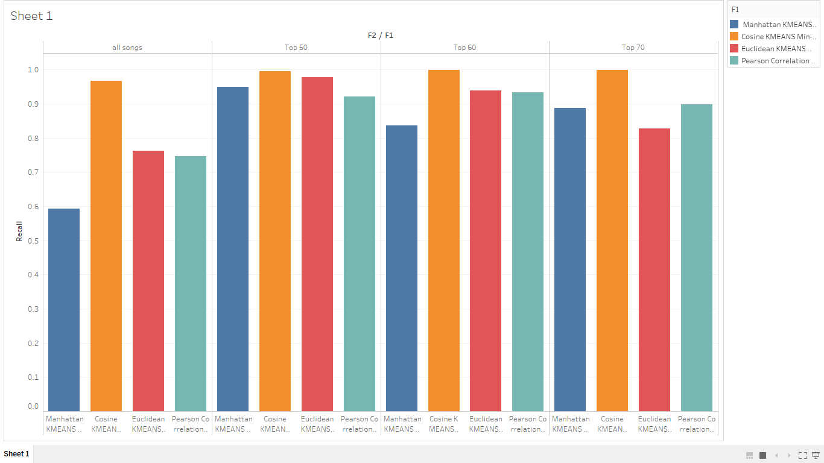
Graph for Recall values of various similarity Measures for different number of recommendation songs

Slide 14
Evaluation values for various Recommendation Systems with different approaches at different ratios of training and testing data and for different number of recommended songs

Slide 15
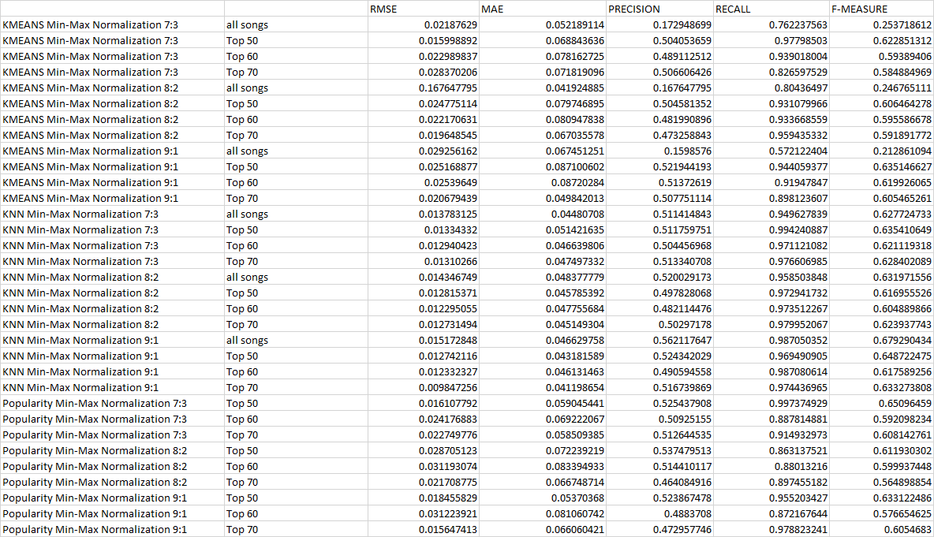

Slide 16
Precision values for various Recommendation Systems with different approaches at different ratios of training and testing data and for different number of recommended songs

Slide 17
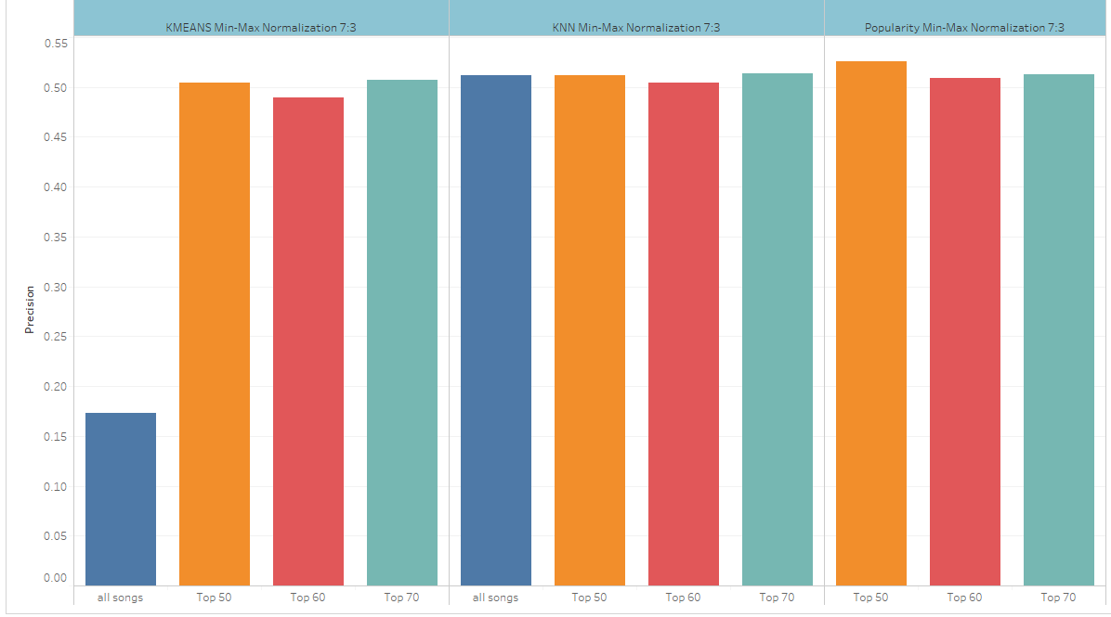

Slide 18
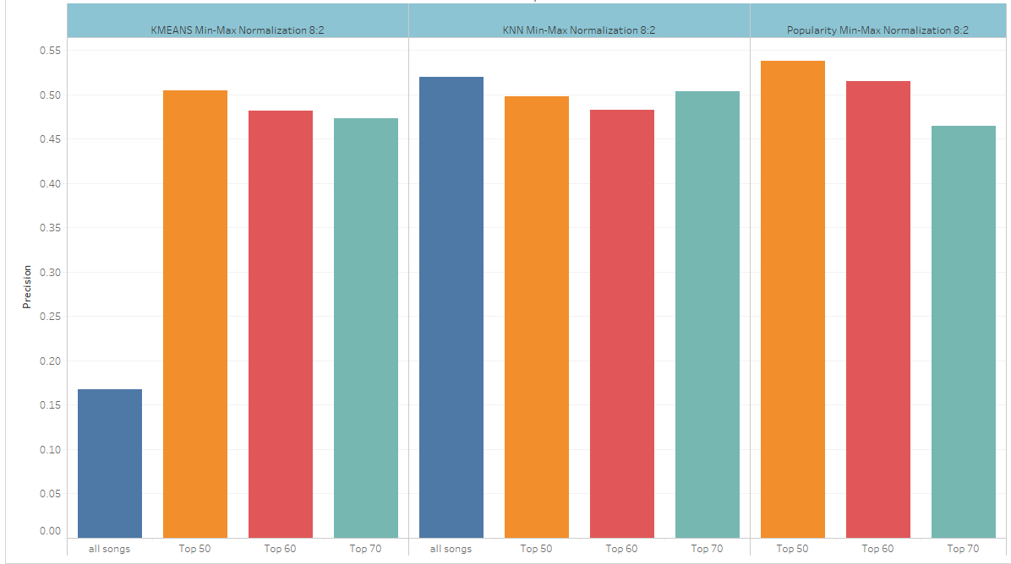

Slide 19
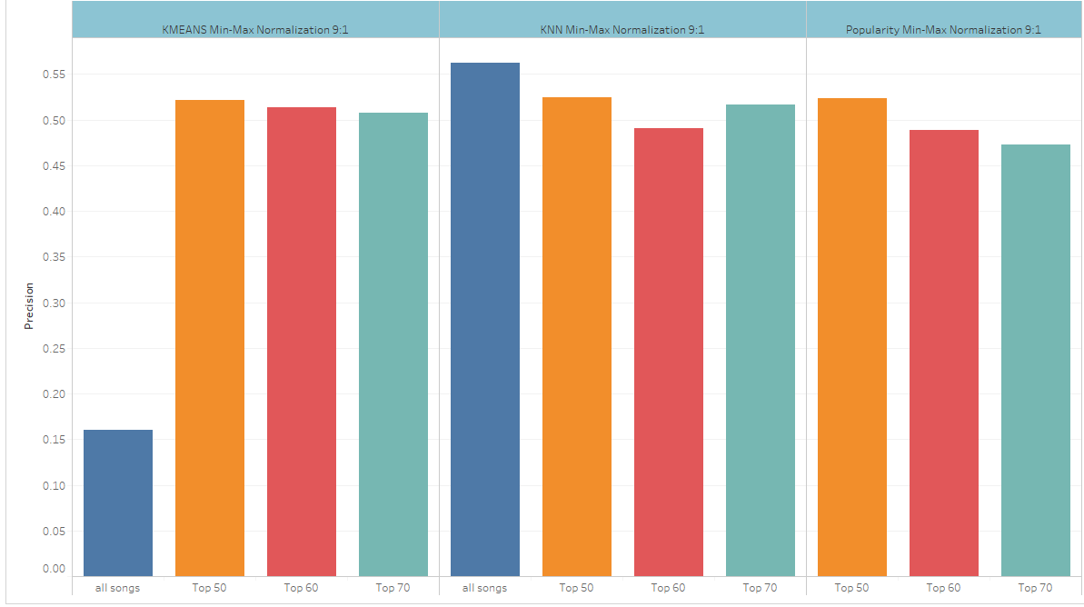

Slide 20
F-Measure values for various Recommendation Systems with different approaches at different ratios of training and testing data and for different number of recommended songs

Slide 21
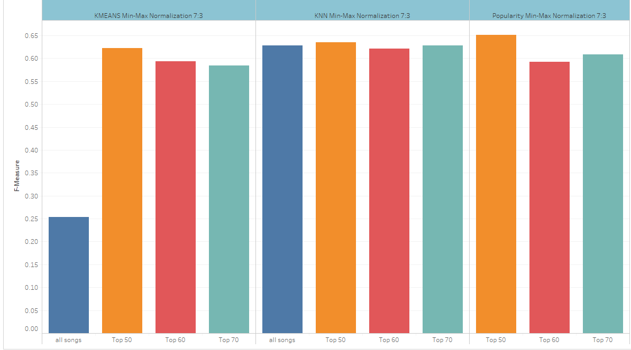

Slide 22
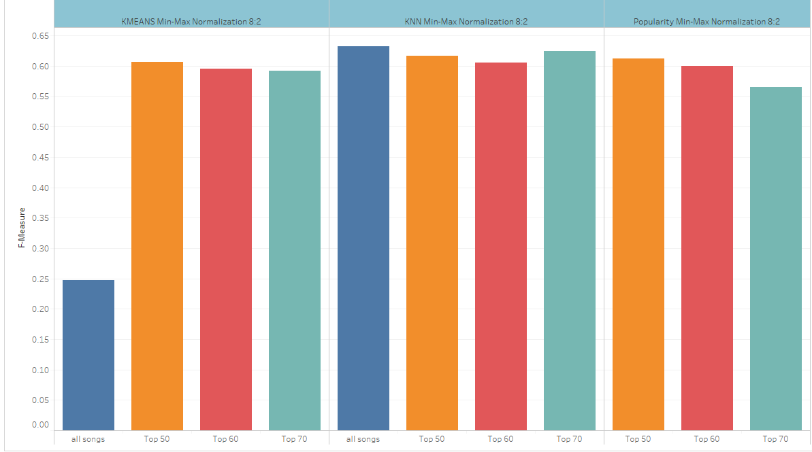

Slide 23
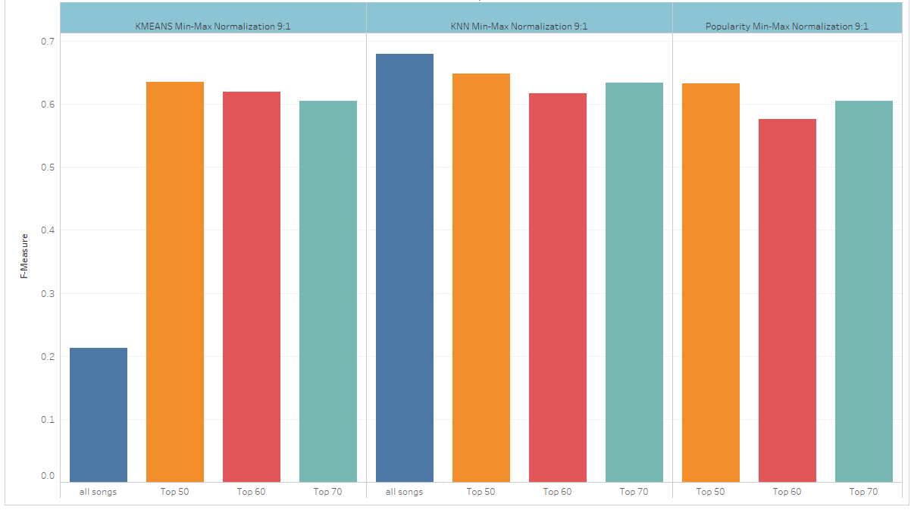

Slide 24
Recall values for various Recommendation Systems with different approaches at different ratios of training and testing data and for different number of recommended songs

Slide 25
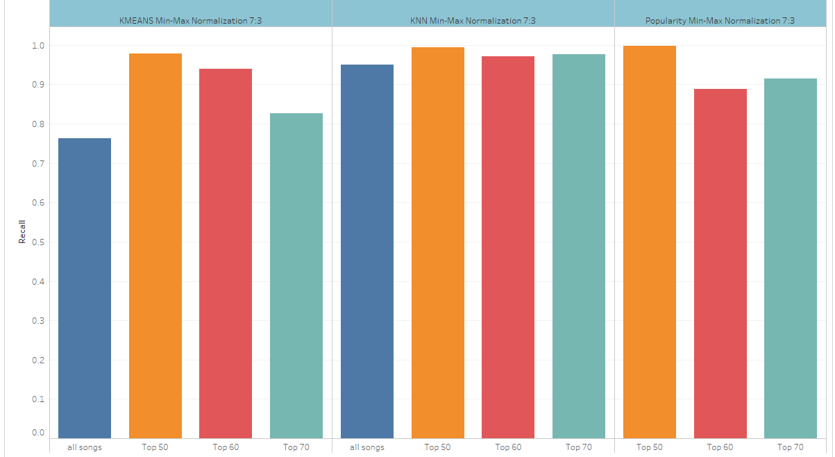

Slide 26
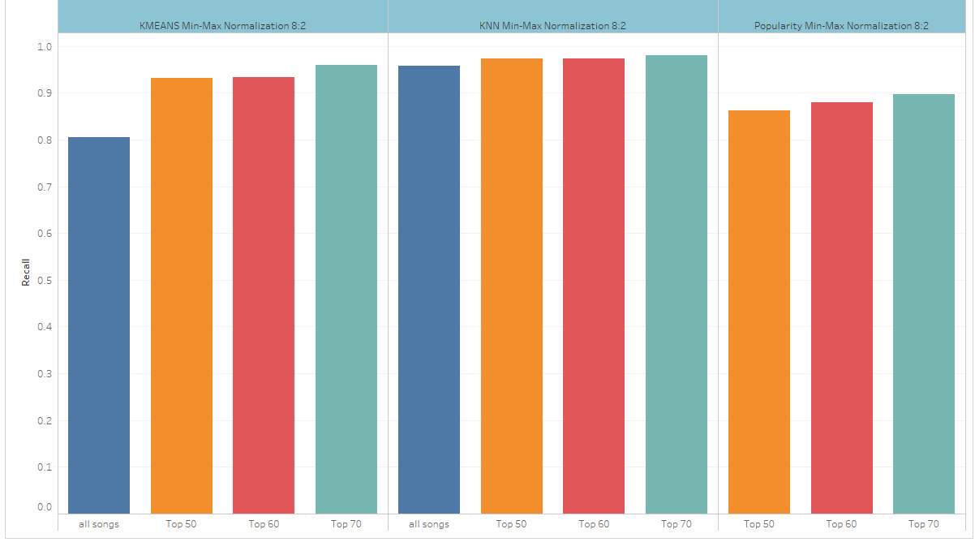

Slide 27
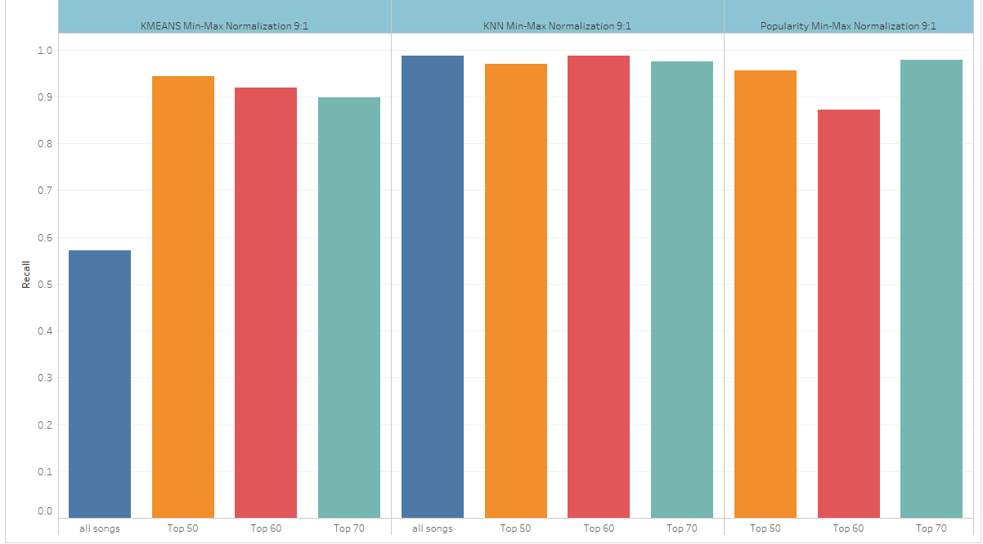

Slide 28
RMSE values for various Recommendation Systems with different approaches at different ratios of training and testing data and for different number of recommended songs

Slide 29
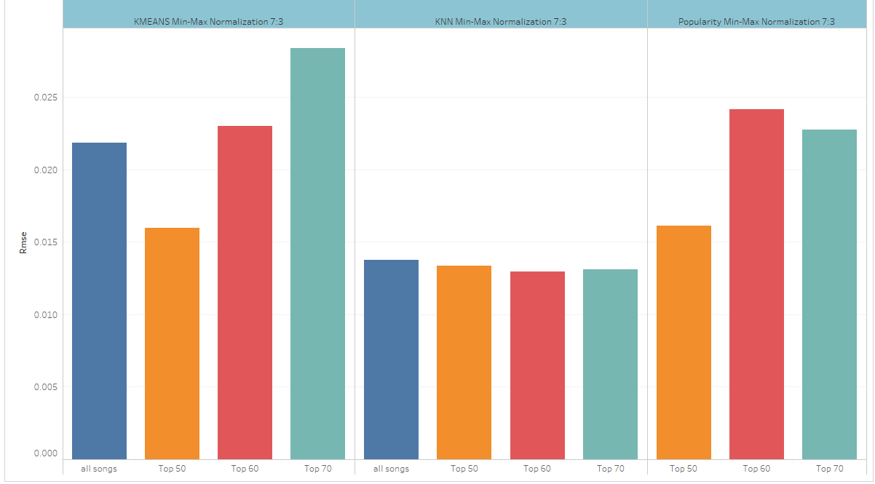

Slide 30
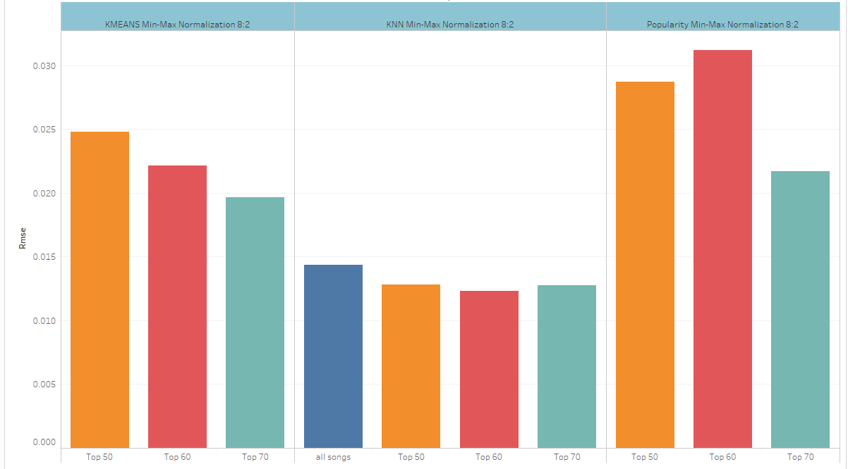

Slide 31
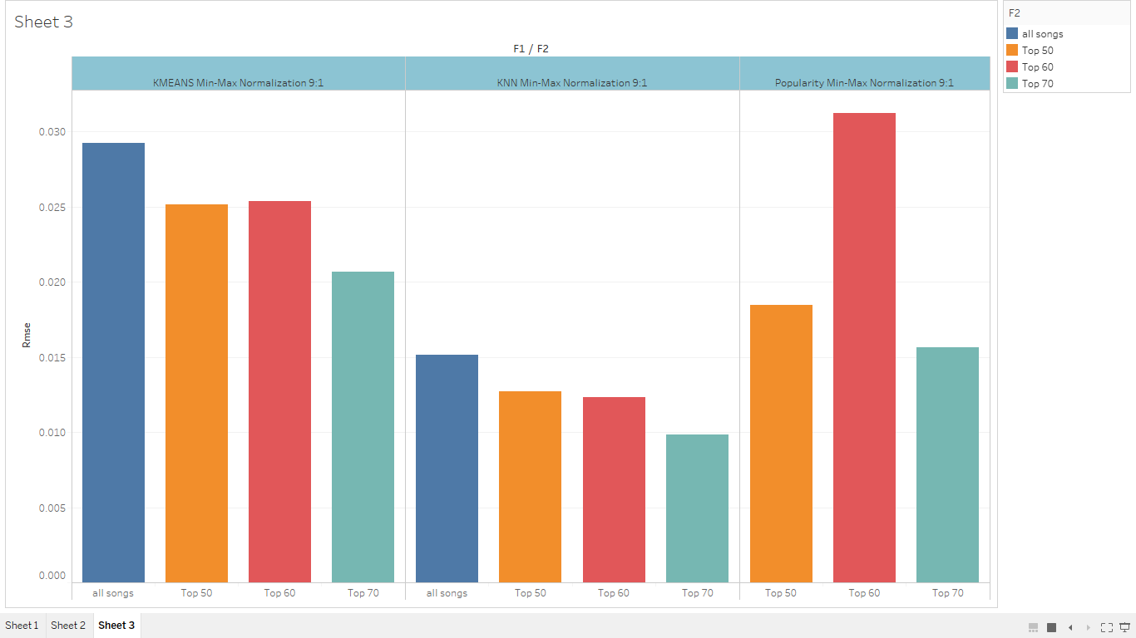

Slide 32
MAE values for various Recommendation Systems with different approaches at different ratios of training and testing data and for different number of recommended songs

Slide 33
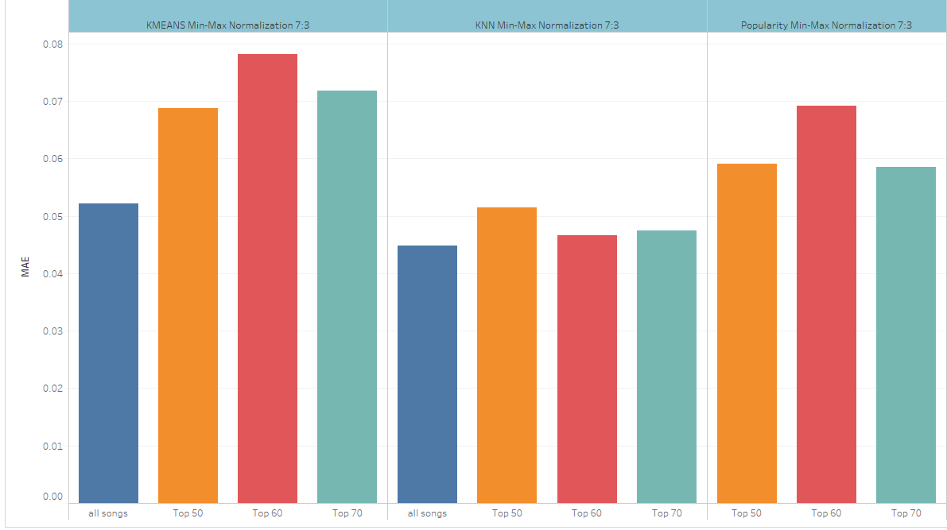

Slide 34
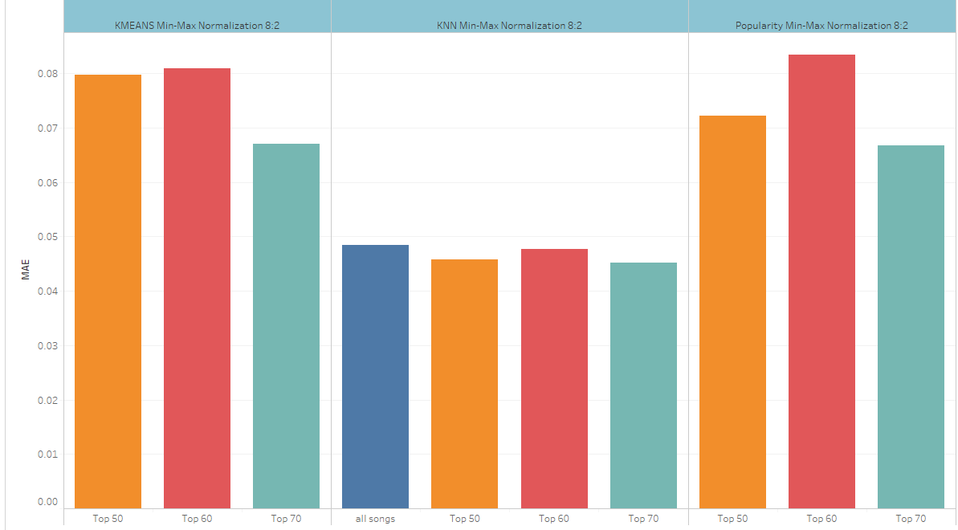

Slide 35
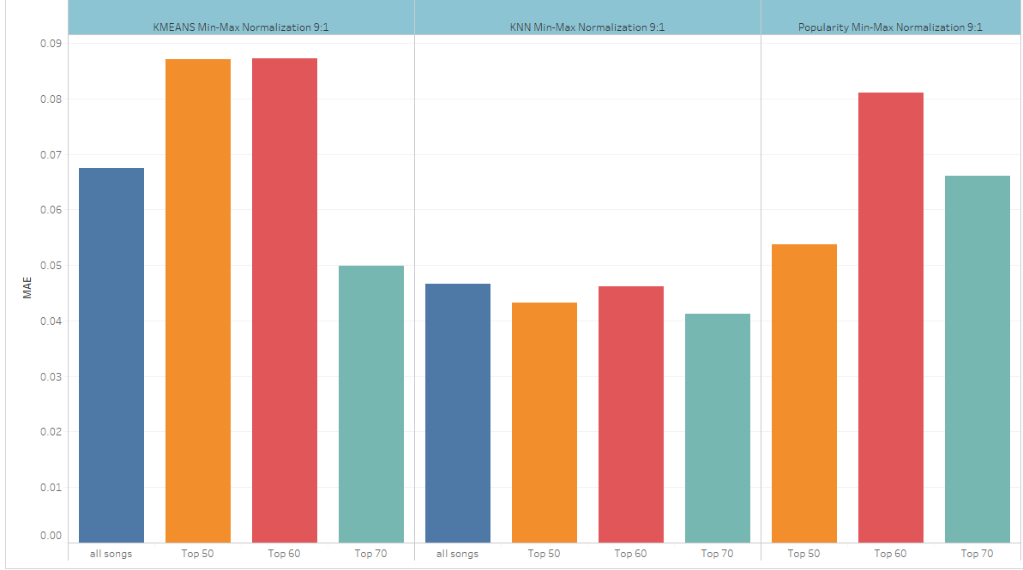

Slide 36
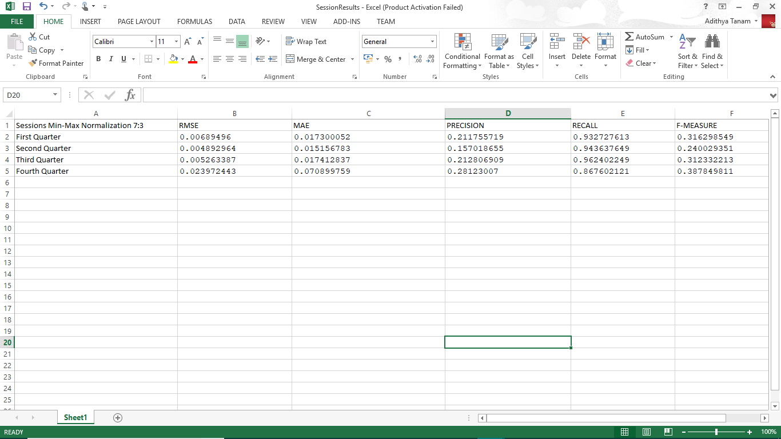
Session Results

Slide 37
